Slide 1

The key to unlocking your health insurance
Notes:
Fonts:
Headers:
56 Regular Reem Kufi
Small Text:
13 Bold Reem Kufi
13 Regular Anaheim
green hex: 8bc6A8

Slide 2


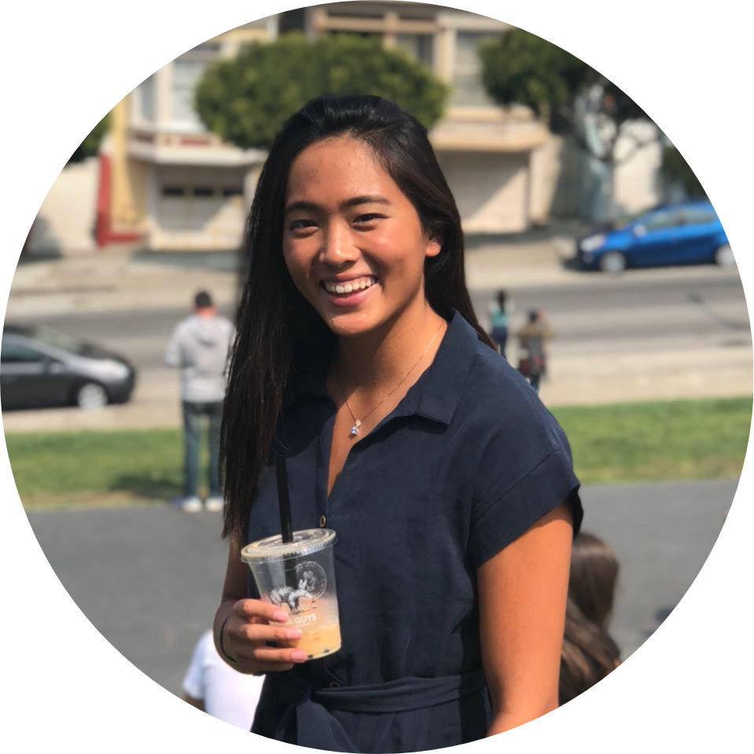


OUR TEAM
MELINDA
VRINDA
M.S. Computer Science ‘20 B.S. Product Design ‘20
M.S. Computer Science ‘21 B.S. Computer Science ‘20
GRACE
SEAN
ARI
M.S. Management Science & Engineering ‘22 B.S. Computer Science ‘21
M.S. Computer Science ‘20 B.S. Electrical Engineering ‘19
B.S. Symbolic Systems ‘20
Notes:
We’re team ask.in. We have a phenomenal set of designers, engineers, and most importantly people who all care about wellness, education, and helping you ...blah.

Slide 3
MEET CLAIRE
Notes:
We wanted to start off by introducing you to Claire. Claire grew up on Medicaid in Louisiana, and when she moved to college in Colorado, she was told Louisiana Medicaid wouldn’t satisfy the school’s insurance mandate. She scrambled to figure out her options before the deadline -- she didn’t know anything about insurance, her trusted network didn’t have answers outside of Louisiana, and the school administration suggested an expensive school insurance plan she couldn’t afford. She wished she had somewhere she could go to get unbiased guidance on her health care transition.
Reference POV:
We met Claire, who moved to a different state for college and had to navigate health insurance for the first time. We were surprised to learn that even though she reached out to her network and school administration, she found the process daunting and lacked confidence in her final decision. It would be game-changing if we could help her feel confident that she chose the best option and is getting the most out of her insurance.

Slide 4
Young adults need higher quality and better access to healthcare and health insurance education
Notes:
Like Claire, we found that young adults at large need higher quality and better access to healthcare and health insurance education, and this is the problem we decided to tackle.

Slide 5
ROADMAP
01
02
03
04
05
06
Needfinding
Solution
Demo
Problem Definition
Design Evolution
Next Steps
Notes:
In today’s presentation, we’ll be going over the design and prototype process, needfinding, problem definition, an overview of our solution, design evolution, a demo of our final prototype, and next steps.
To see this, we will go over our
needfinding
problem definition,
solution
design evolution with user interface highlights
demo
and next steps.

Slide 6
Needfinding
Notes:
As discussed in previous presentations, our team’s initial research found that Young adults need higher quality and better access to healthcare and health insurance education.
In particular, we found that health insurance education is a leading barrier to better healthcare education.

Slide 7

GOALS
identify pain points
explore current “solutions”
define engagement with health insurance
Notes:
grace
in our need finding process, we had three goals in mind
first, to identify pain points, second to explore current solutions people are using, and third, to define our user’s engagement with health insurance (meaning how frequently, when, and for what scenarios)

Slide 8
WHO WE INTERVIEWED
A recent college grad who started her first job and transitioned insurance plans
An immigrant who leads a non-profit that supports undocumented young adults
An MD who runs one of three young men’s clinics in the country and is a health literacy advocate
An ophthalmic technician from Connecticut who grew up on Medicaid and will be transitioning to company insurance
A recent college grad who switched from LA Medicaid to CO Medicaid for college
A student health program manager at a university health center tackling wellness amongst young adults
Notes:
grace
as you can see, we interviewed a large breadth of people for our need finding research. This included people who were on medicaid, young adults and recent grads, and experts who speciazlied in healthcare education for young adults

Slide 9
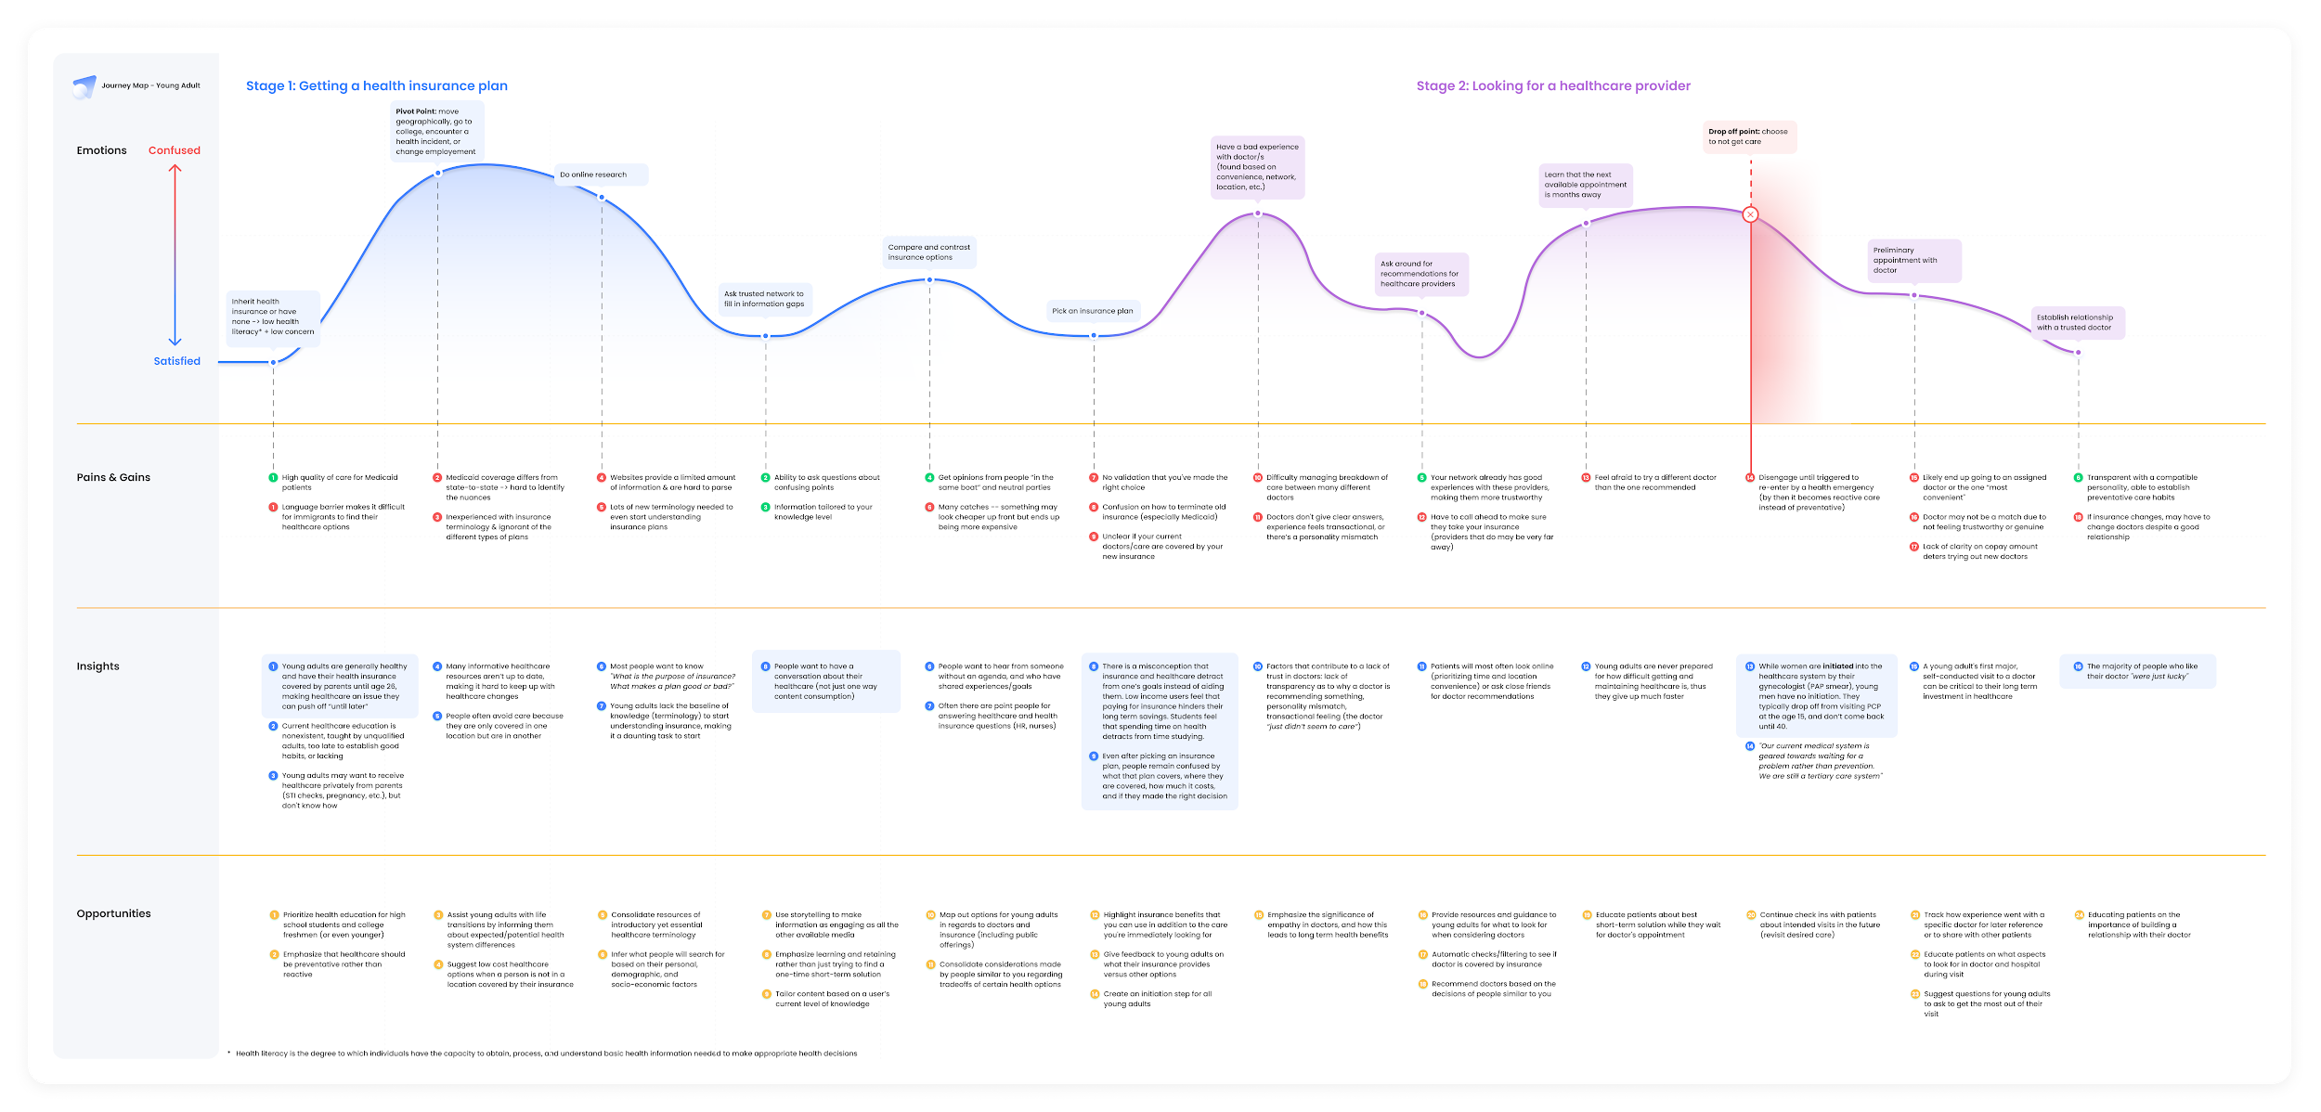
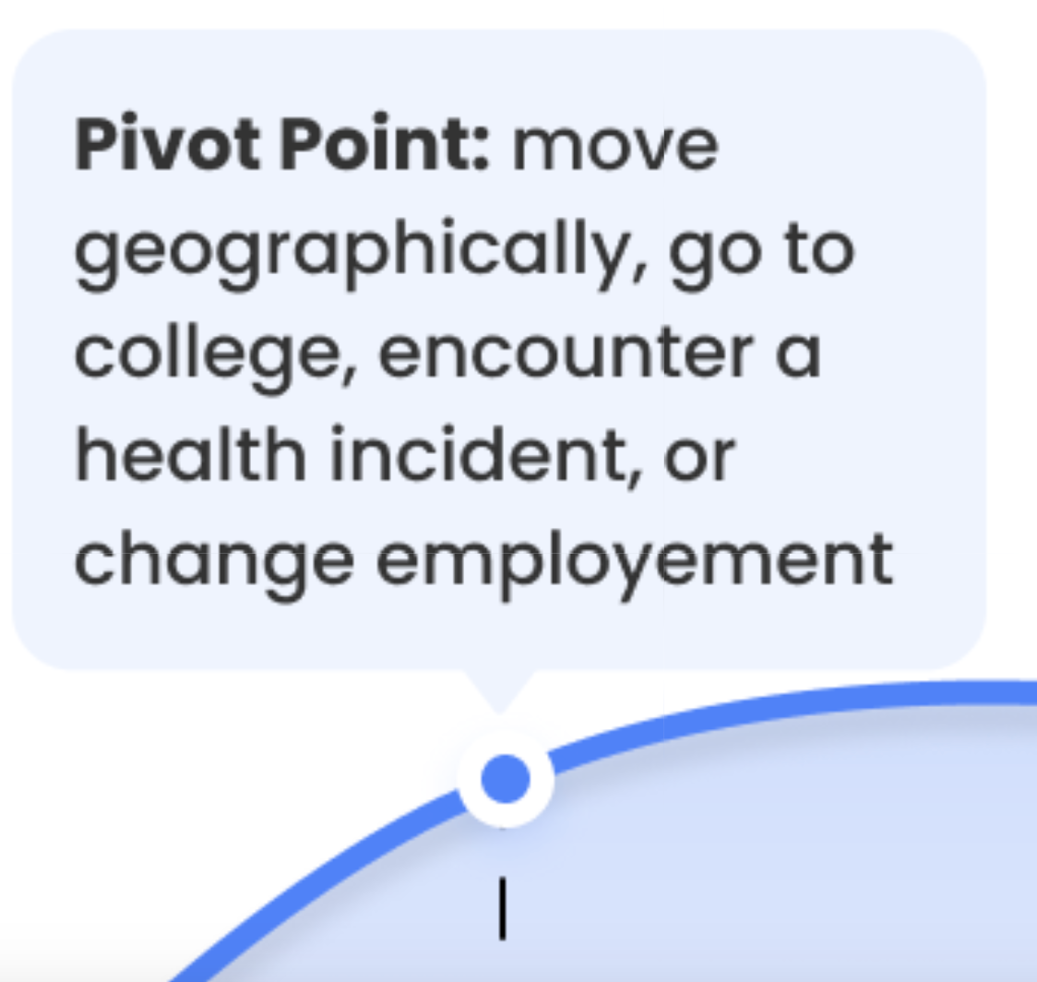
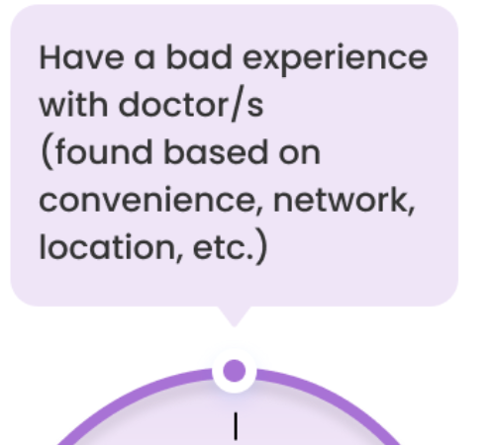
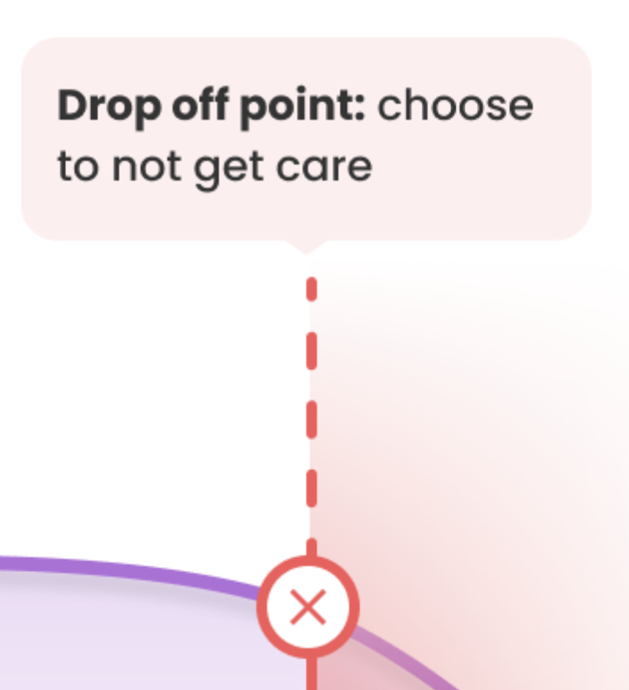
Insights
Notes:
grace
we synthesized our research findings into this journey map, which maps out a young adult’s experience with healthcare and health insurance. I’m going to highlight three key insights from this.
first is people always encountered a pivot point which forced them to engage with and learn about health insurance.
second is people often have a negative initial experience with their doctor bc they found them through convenience of network/location
this then leads to a drop off, where they choose not to seek further care —> this is detrimental to their long-term health

Slide 10
Insights
Conversations with coworkers, family, and friends to solicit advice
Notes:
grace
another thing we found was that throughout this journey, people were constantly having conversation w… because it is the most trustworthy source of information they had access to

Slide 11
Problem Definition
Notes:
Ari
Problem definition
From this, we focused our problem definition
--
other:
learned that health insurance education is a leading barrier to better healthcare education
and that while people seek this information, they often do so within their communities.
e were able to define the root problem definition..

Slide 12
THE PROBLEM
Young adults need a trustworthy source of health insurance education to help navigate their lifelong healthcare journey
Notes:
Ari
Young adults need a trustworthy source of health insurance education to help navigate their lifelong healthcare journey

Slide 13
Solution
Notes:
Ari
Our team reimagined teach young adults (YAs)
how to navigate their lifelong healthcare journeys and foster a culture of preventative care
As discussed in previous presentations, our team’s initial research found that
Young adults need higher quality and better access to healthcare and health insurance education.
In particular, we found that health insurance education is a leading barrier to better healthcare education.
As a result, we tested these partos of our past interactions and ultimately moved forward with one design.
How? Product that helps people get and give hard to find, yet more often than not, simple health insurance answers
disclose your personal interests to us
review ask.in’s recommendations on most important insurance fields you should consider based on your health interests
choose which filters you agree are relevant and want to apply to your search, profile, and/or questions for us to extract from the plans
get feedback on your question from people who are credible for the filters you selected about what the best next steps are / what the absolute priority shoudl be for you to conisder when choosing your plan
you can also vote on other people’s insurance plans that you’ve had experience with to give back to the community - reciprocity is always goodd

Slide 14
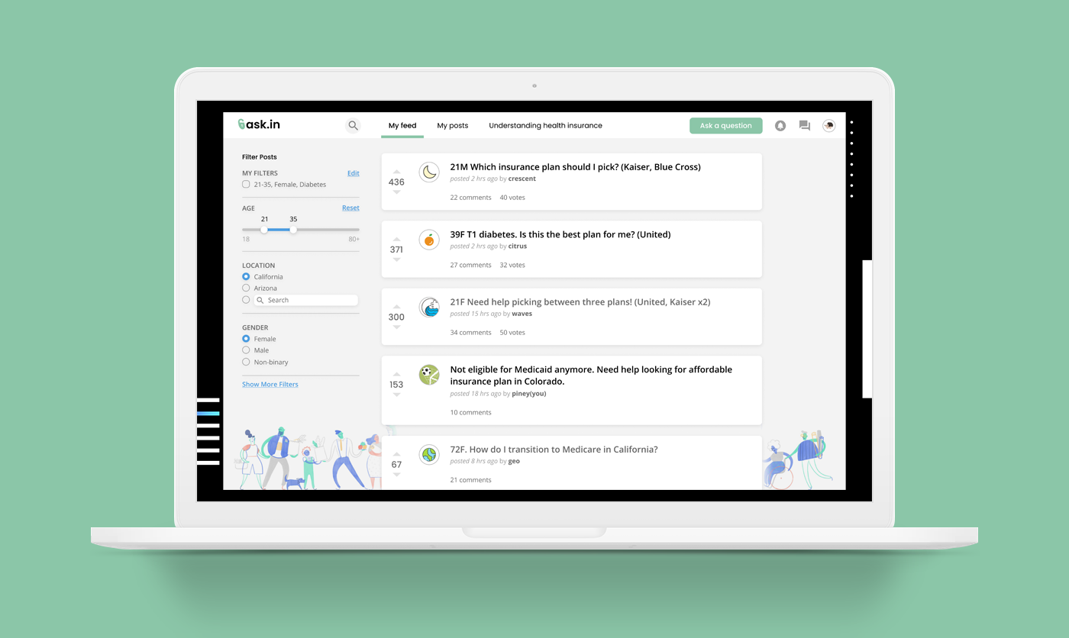
A health insurance forum, with hassle-free detail extraction and optimal organization of feedback from peers
Notes:
Ari
Our Solution
In order to address this problem, and our solution to this was ask.in,
a health insurance forum,
with hassle-free insurance detail extraction
and optimal organization of feedback from peers.
To kickoff our ideation process,
we started off with around twenty different concept sketches.
ranging from group video chats to discuss insurance plans to AR healthcare visits with experts.
And Melinda will walk us through the main tasks our low fi prototype resulted in as well as where we went from there and through the design evolution

Slide 15
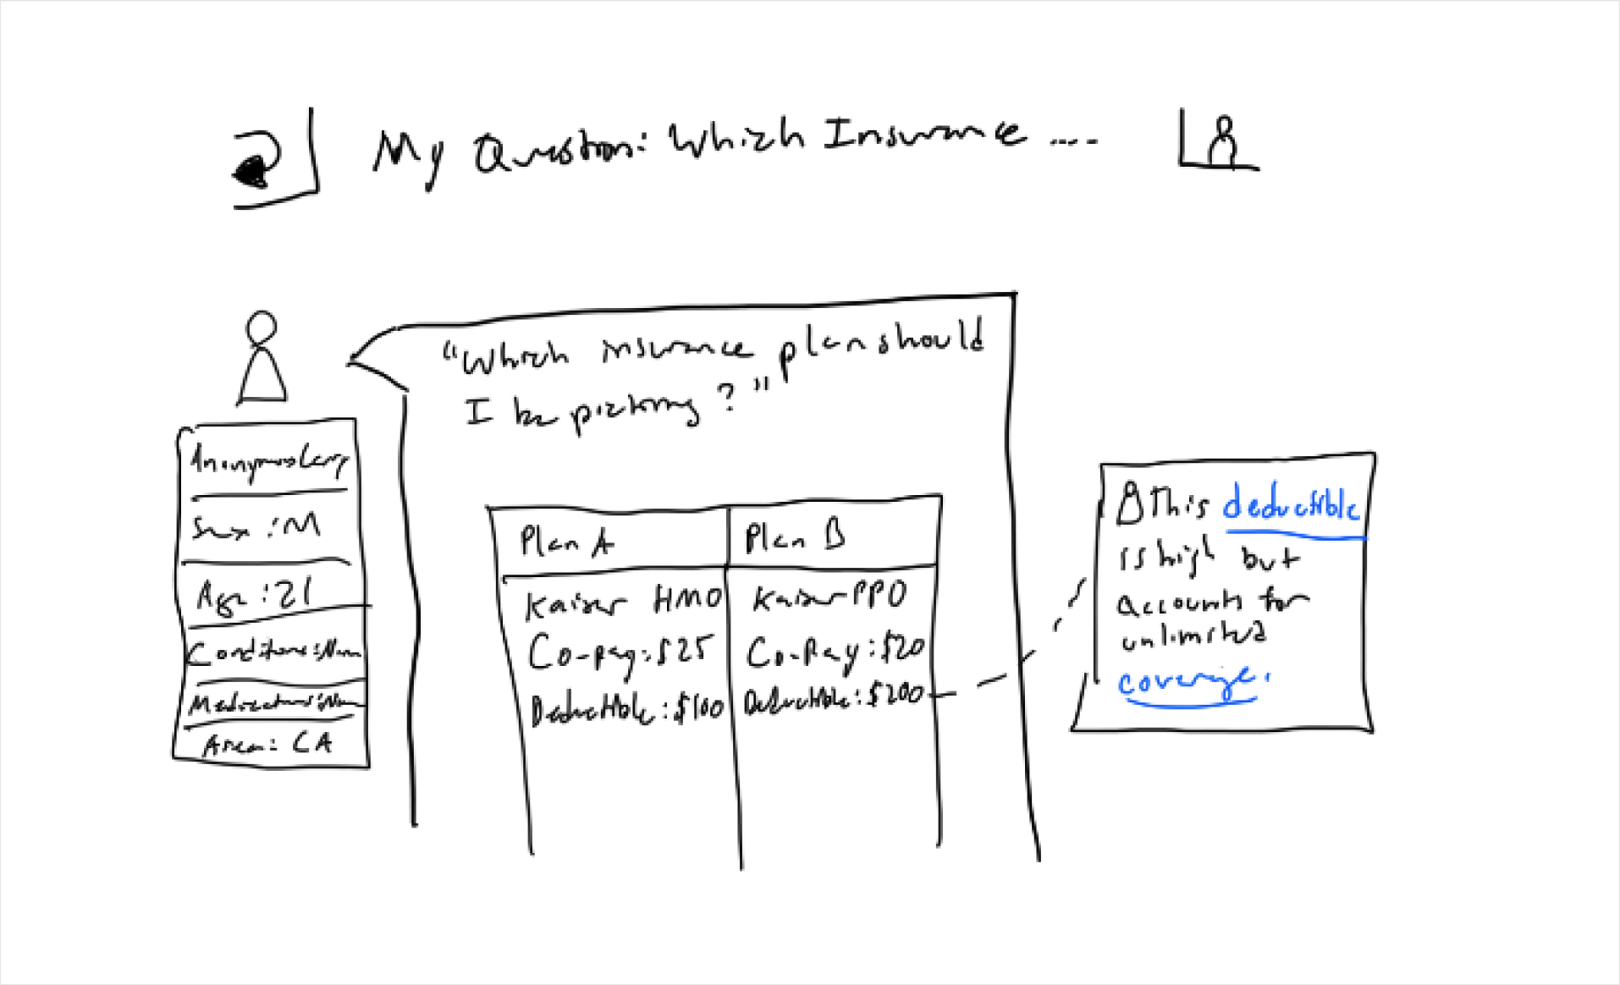
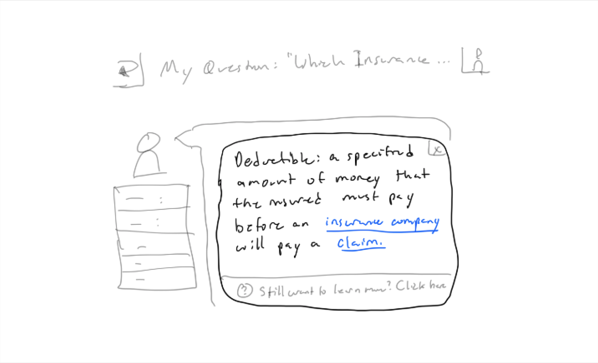
Task 1: Define health and insurance terms
Low-Fi Prototype
Notes:
We focused on helping our users accomplish three key tasks on our platform
The first is viewing the definition of a health insurance term, so that users that don't know much about insurance can still understand comments and posts without leaving the platform, and as a result can better engage with the community

Slide 16
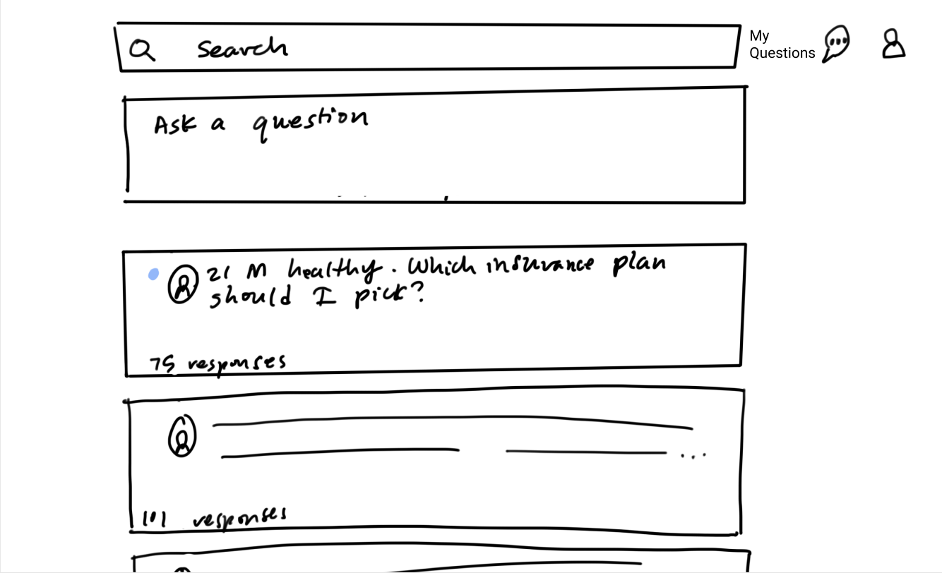
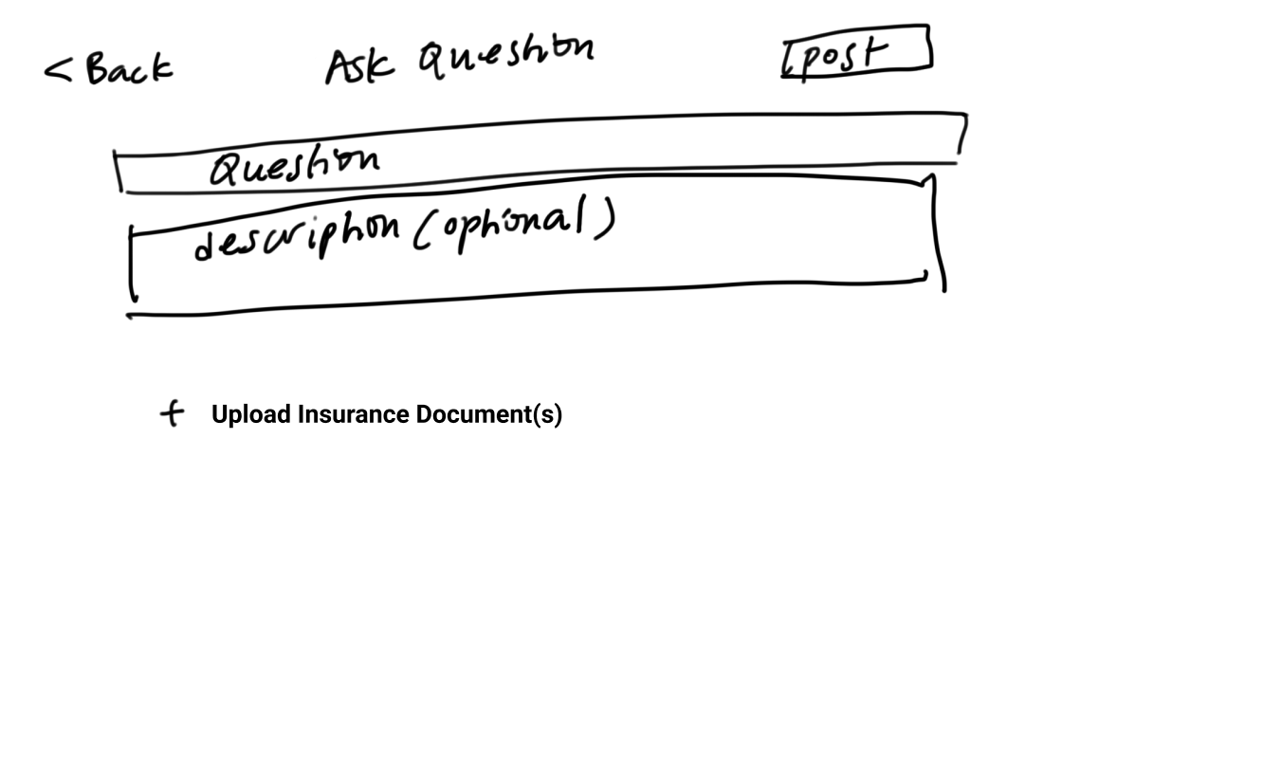
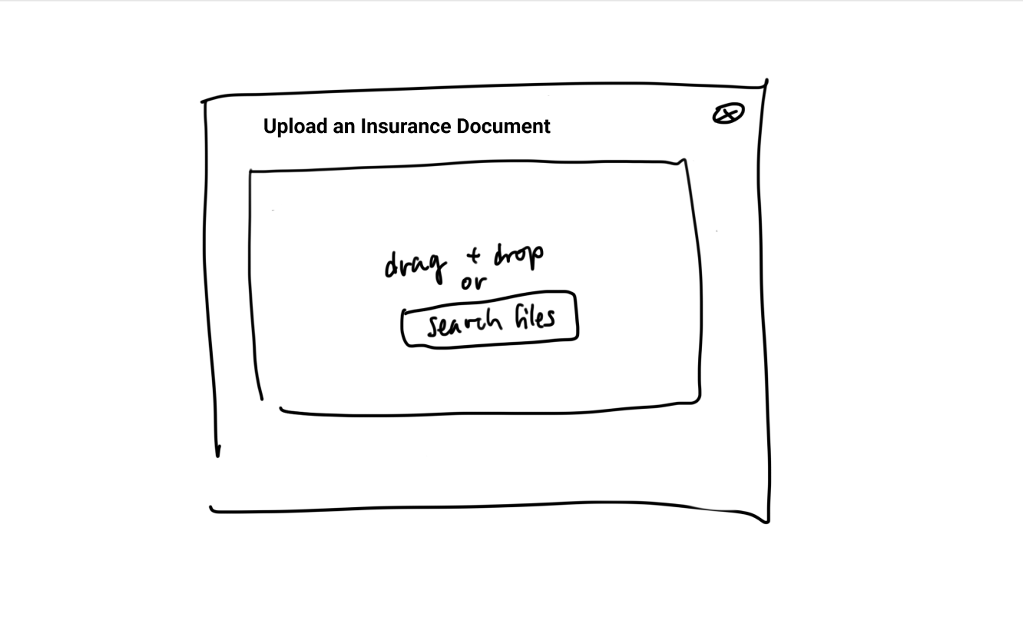
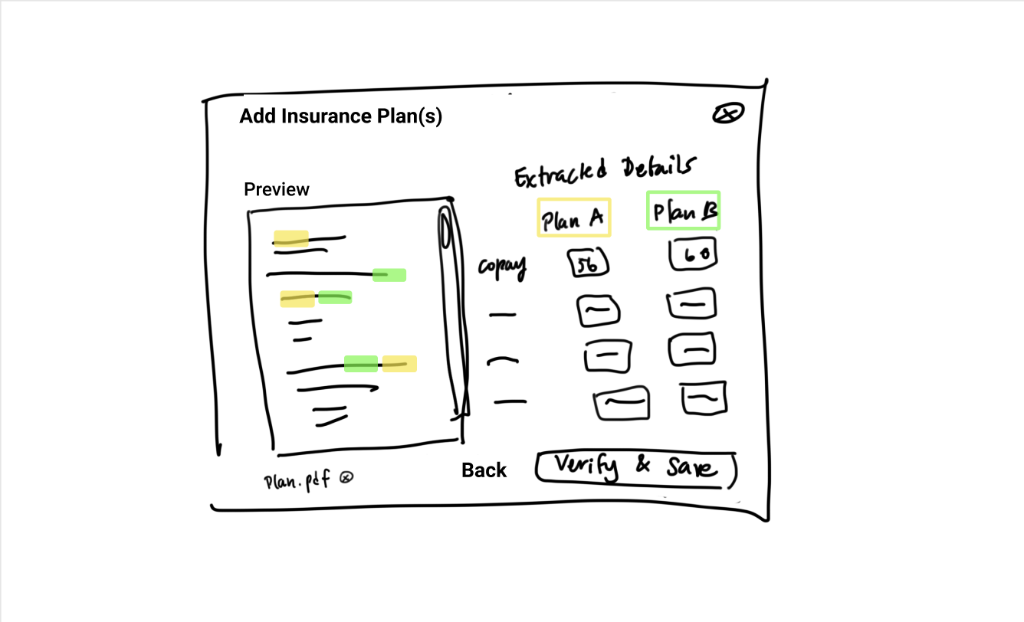
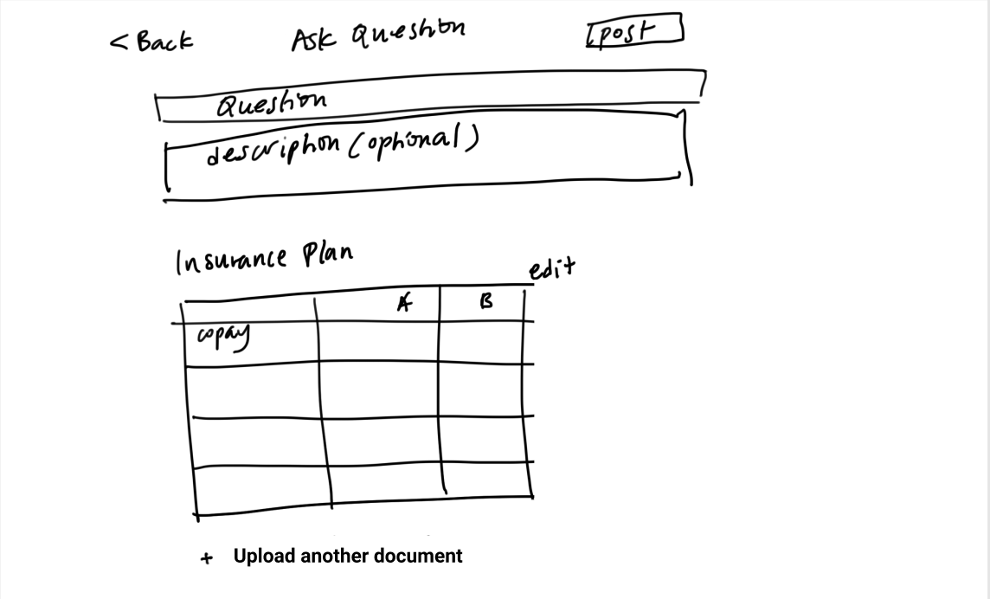
Task 2: Ask a question about your insurance plan
Low-Fi Prototype
Notes:
The second task is allowing users to post a question about their insurance. You can see that the platform extracts and anonymizes insurance information, which makes it easier to post on our platform than an alternative where you'd have to go in and manually anonymize your insurance document

Slide 17
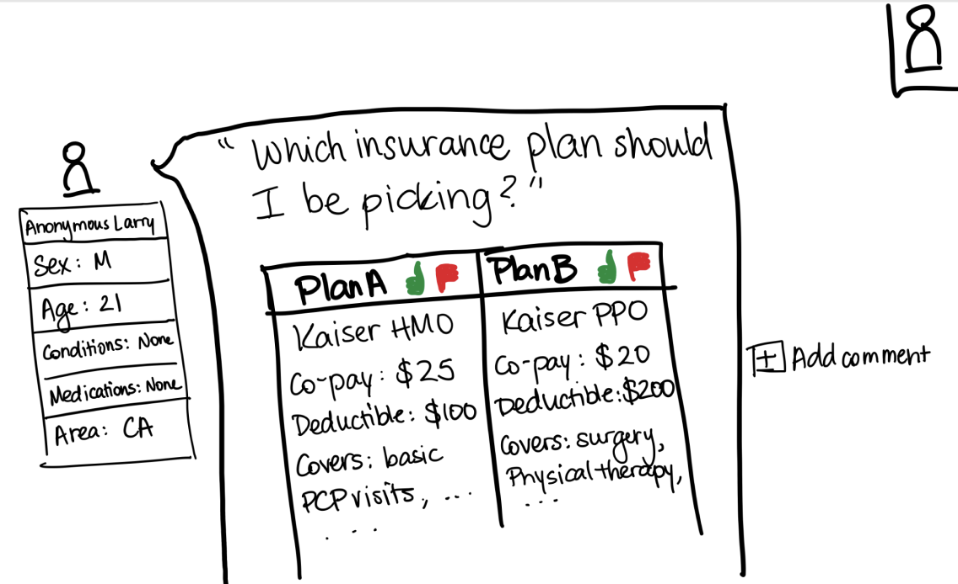
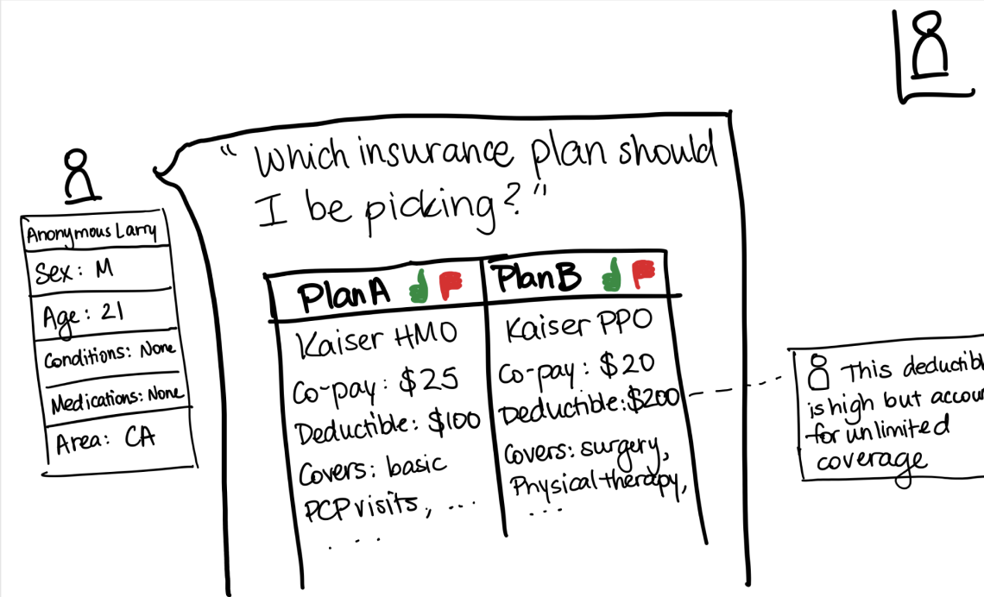
Task 3: Voting and commenting on insurance plans
Low-Fi Prototype
Notes:
remember to use a LASER POINTER for the presentation :D and box the added comment on the right
Finally we wanted to allow users to vote and comment on insurance plans. In this way, people can get a consensus on what insurance is the best for them, as well as read through reasoning to understand the pros and cons of a plan

Slide 18
Design
Evolution
Notes:
To teach young adults (YAs)
how to navigate their lifelong healthcare journeys and foster a culture of preventative care
As discussed in previous presentations, our team’s initial research found that
Young adults need higher quality and better access to healthcare and health insurance education.
In particular, we found that health insurance education is a leading barrier to better healthcare education.
As a result, we tested these partos of our past interactions and ultimately moved forward with one design.
How? Product that helps people get and give hard to find, yet more often than not, simple health insurance answers
disclose your personal interests to us
review ask.in’s recommendations on most important insurance fields you should consider based on your health interests
choose which filters you agree are relevant and want to apply to your search, profile, and/or questions for us to extract from the plans
get feedback on your question from people who are credible for the filters you selected about what the best next steps are / what the absolute priority shoudl be for you to conisder when choosing your plan
you can also vote on other people’s insurance plans that you’ve had experience with to give back to the community - reciprocity is always goodd

Slide 19
Iteration Process
Reddit-style Forum Usage
Insurance Types
Technology Usage
Employment Status
Healthcare knowledge
Industry
5 interviewees
Low-Fi
Med-Fi 1
Med-Fi 2
Med-Fi 3
Final
Prototyping Stages
Notes:
Now that we had the base prototype, we improved the design through a few rounds of interviewing
After each prototype version, we recruited 5 interviewees and conducted usability testing, allowing them to click through our figma prototype and see what issues they had
Within these interviewees we aimed for an even distribution of familiarity with forums like reddit, facebook, and quora,
We also aimed to interview people` with different types of insurance, different employment statuses, and different industries of employment
You can see all the versions of our prototype from low-fi, to med fi 1, to med fi 2, to med fi 3, to our final prototype in this progress bar that will be visible as we go through our main design changes.

Slide 20

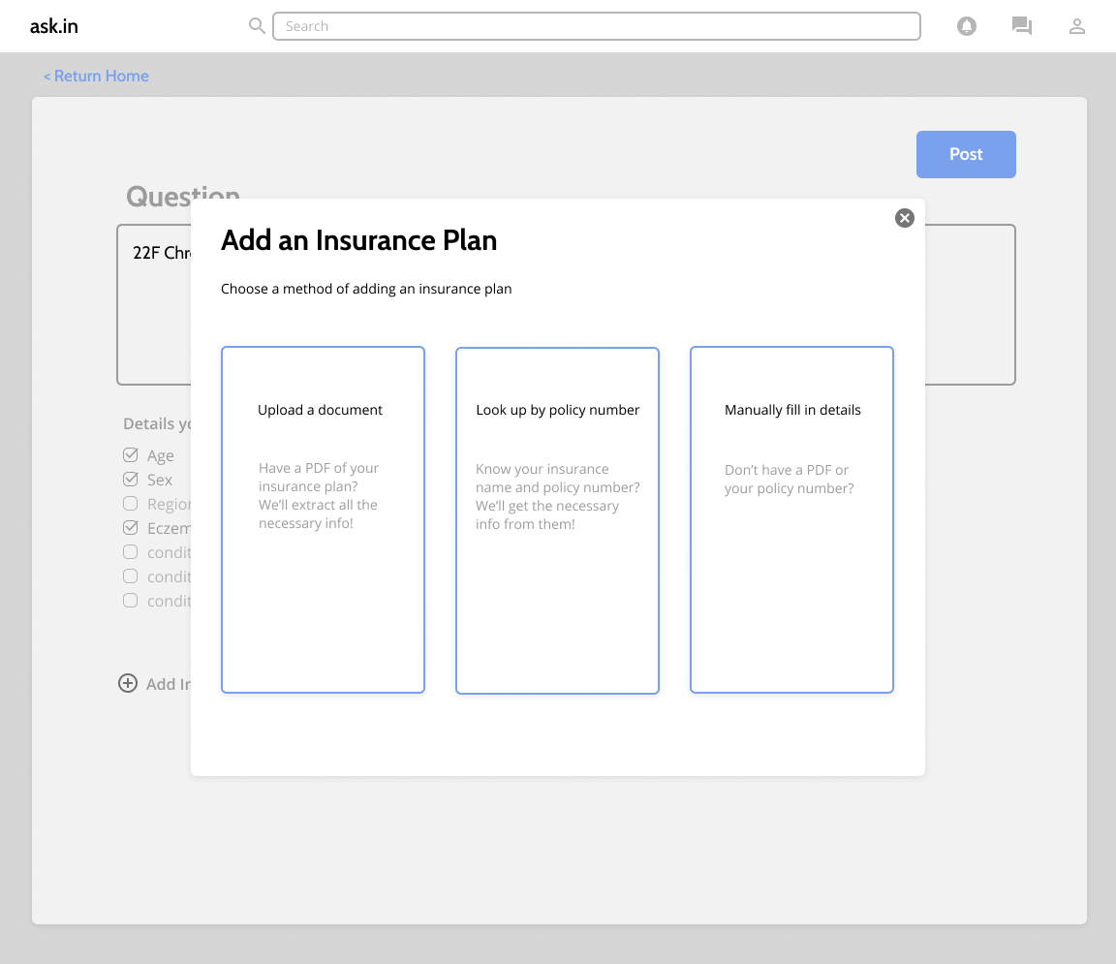
Design Change - Uploading an Insurance Plan
Some users don’t have an insurance document to upload
Allow for manual information entering or lookup by policy number
L1
M1
M2
M3
F
L1
M1
M2
M3
F
Prototype Stage
Prototype Stage
Notes:
use pointer to highlight changes
Our first finding was that many users didn't have insurance documents to upload. Some would receive paper documents or want to look up their policy
So we added flexibility to the insurance upload process
You can see here we allow them to not only upload by insurance document, but also by looking up a policy number or manually filling in details

Slide 21
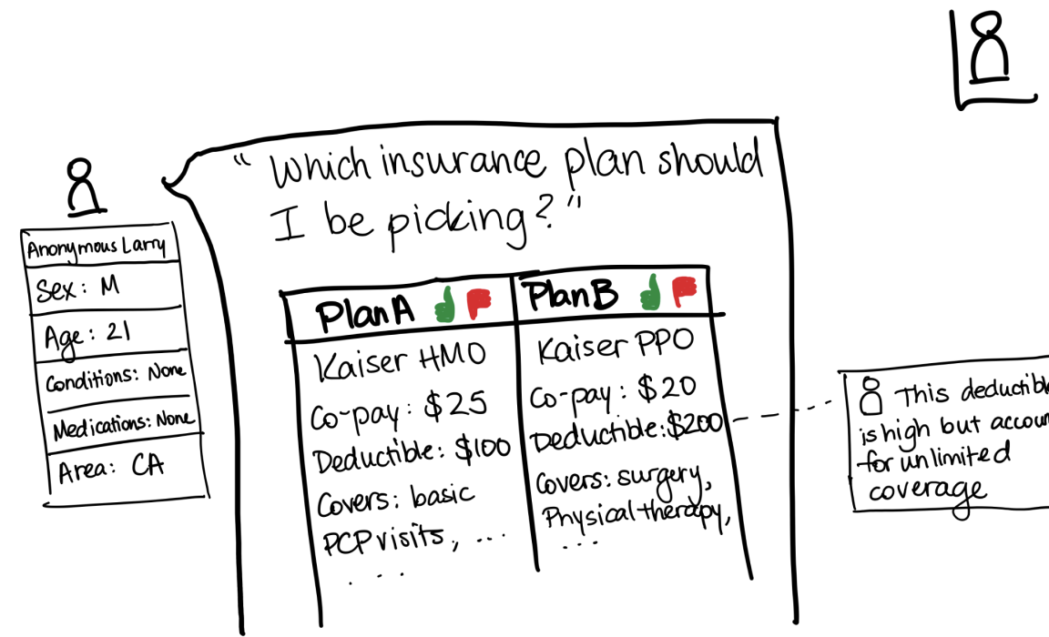
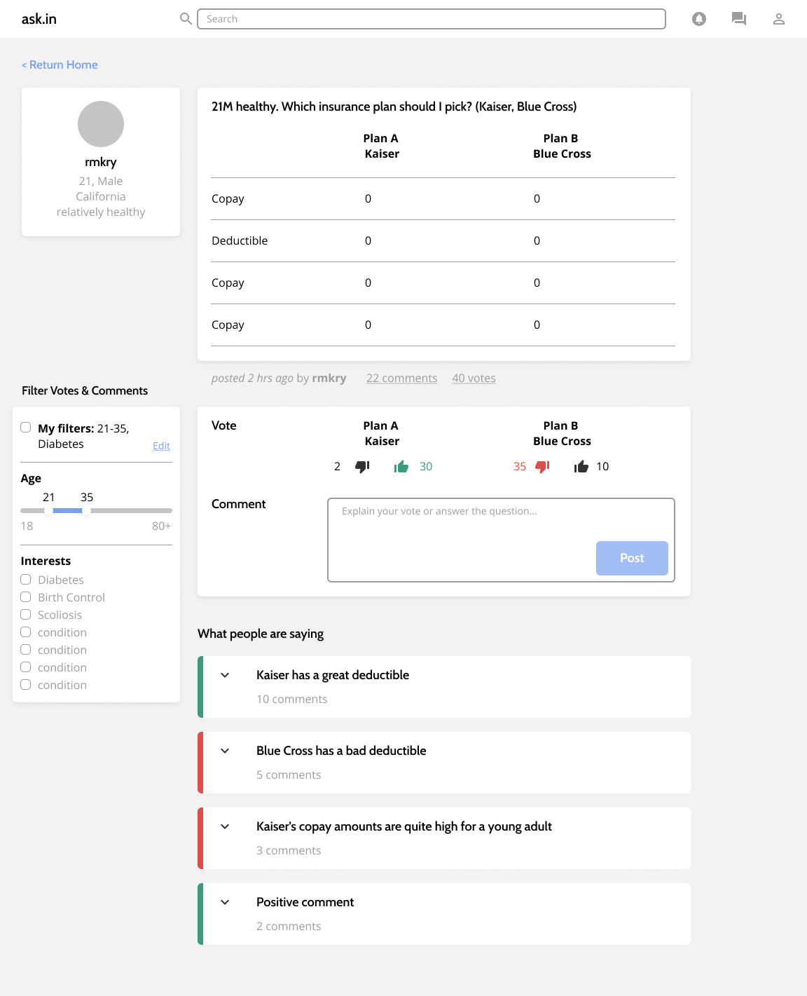
Design Change - Comment Grouping
Users don’t want to sift through comments on a plan
Use AI to group comments by sentiment
L1
M1
M2
M3
F
L1
M1
M2
M3
F
Prototype Stage
Prototype Stage
Notes:
The next thing we found was that many users were concerned about having to sift through comments on their question. They also didn't know how the UI of having comments on specific insurance document elements would scale for a large numbers of comments
So moved commenting below the actual insurance plan and introduced sentiment grouping. In this way users can scan for the most commonly stated ideas

Slide 22
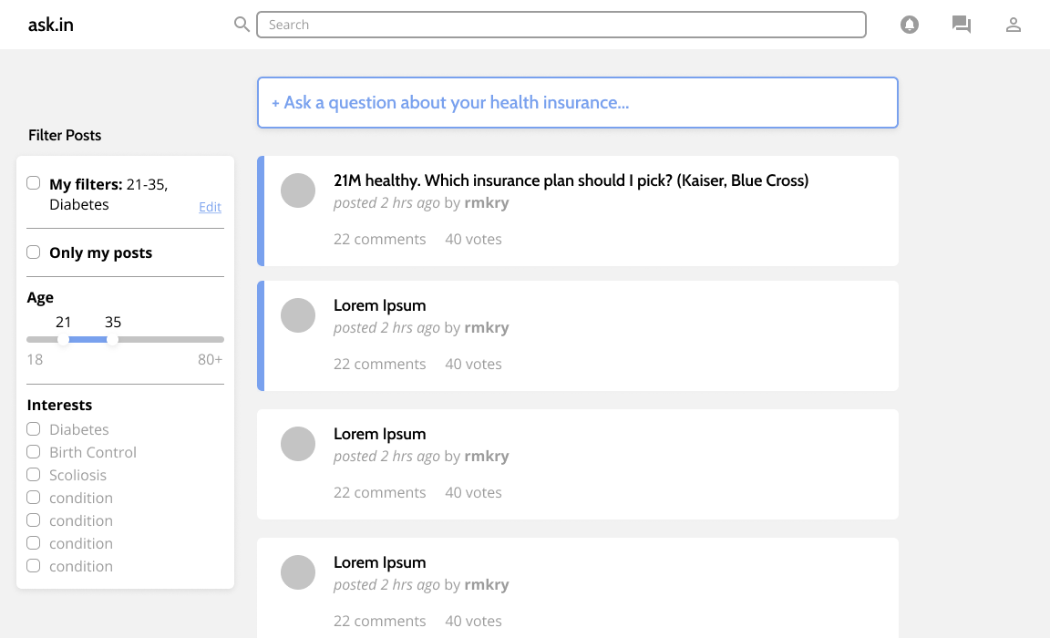
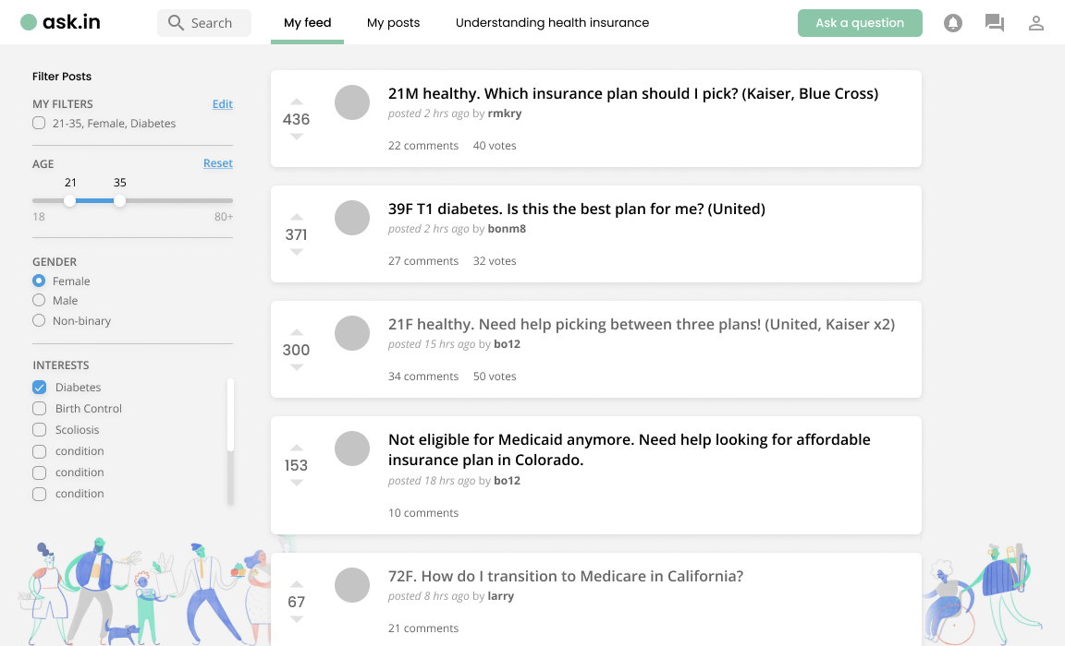
Design Change - Visual Design
Users want friendlier colors
Bring in illustrations, new colors and rounded fonts
L1
M1
M2
M3
F
L1
M1
M2
M3
F
Prototype Stage
Prototype Stage
Notes:
Concerning visual design, people wanted friendlier colors
You can see in the original design we were only using blues and greys, which didn't make people feel welcome
So in our redesign we brought in illustrations as well as rounder fonts

Slide 23
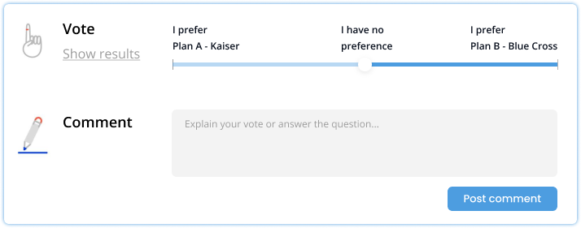
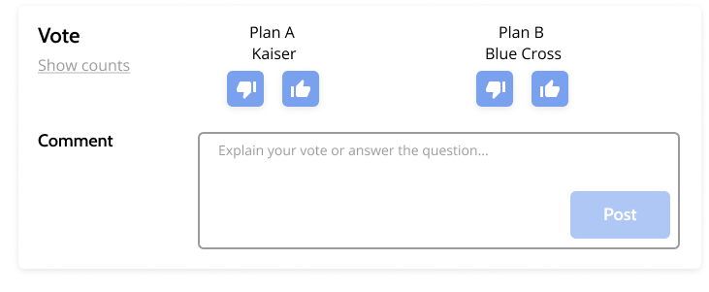
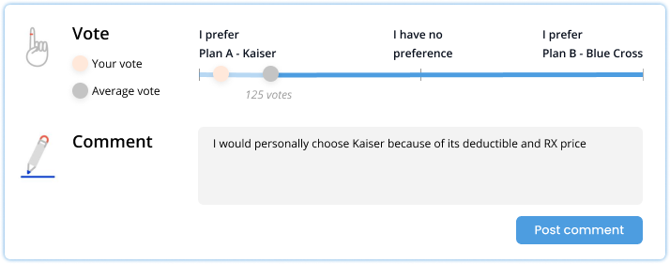
Design Change - Voting
General confusion about being able to vote for both insurance options
Switch to a sliding scale and show the average vote
L1
M1
M2
M3
F
L1
M1
M2
M3
F
Prototype Stage
Prototype Stage
Notes:
Moving on, we did find that some people liked being able to vote up or down for both plans, while some people preferred only being able to recommend one plan
In order to accommodate both preferences for voting we introduced a slider
This way you can either recommend one plan by sliding to the left or right. Or you can vote in the middle to show that the plans are equal.

Slide 24
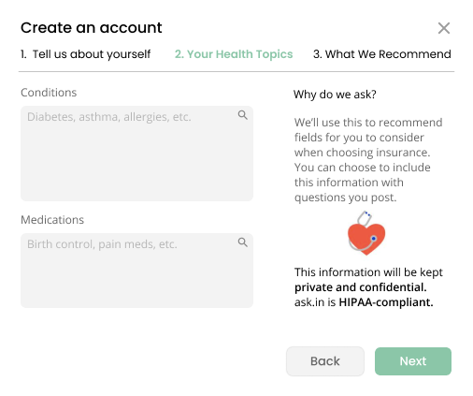
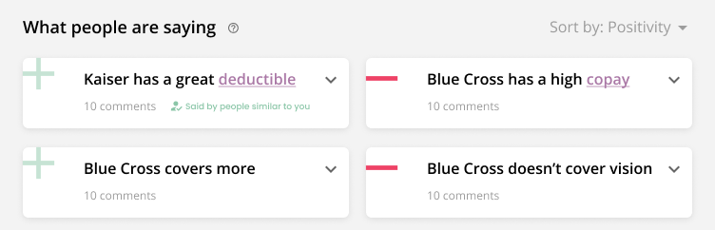
Design Addition - Trust
People don’t trust everyone who is posting
Customize people’s experience based on their health history and interests
L1
M1
M2
M3
F
Prototype Stage
Notes:
Finally one thing we struggled with was making sure users trusted our site as well as the feedback they were receiving from other users on the site. We heard that a lot of users would only trust feedback from people who went through the same health experiences as them
To do this we introduced an account creation flow that helps customize people's experience based on their health background and interests
You can see the sign up modal which clarifies that we are not sharing their data with third parties
After filling this information out I can see that comments from similar users are highlighted, so I can take this account when reading feedback

Slide 25
USAGE OF AI
DETAIL EXTRACTION
SENTIMENT ANALYSIS
Key details auto-extracted from uploaded insurance plan
Comment content classified as positive, negative, or neutral
RECOMMENDATION
CLUSTERING
Personalized shortlist of insurance plan fields to review, generated from user specified health topics
Comments grouped by meaning and sentiment
Notes:
Ari
the ask.in platform leverages AI to guide young adults on their insurance journeys
our main features …
The ask.in platform uses AI to extract insurance information from uploaded plans,
Extract key details (i.e. copay amount) from a user’s uploaded insurance plan PDF.
Key details auto-extracted from uploaded insurance plan
recommend detail fields to our users for their posts based on their personal information and interests.
Personalized shortlist of insurance plan fields to review, generated from user specified health topics
Based on the health topics a user selects, recommend fields of importance for them to consider when evaluating and asking questions about insurance plans
Sentiment Analysis to mark comments as positive, negative, or neutral
Comment content classified as positive, negative, or neutral
Based on a user’s comment, understand whether this comment is positive, negative, or neutral.
Comments grouped by meaning and sentiment
and cluster similar comments based on meaning and sentiment to save our users from having to sift through them - comment grouping
Group together similar comments based on meaning and sentiment, to save users from sifting through them.

Slide 26
Demo

Slide 27

Notes:
Vrinda

Slide 28
Next Steps

Slide 29
NEXT STEPS
FEATURE PRIORITIES
RESOURCES & PARTNERSHIPS
Health and location-based communities
Community moderators
Coach & mentee matching
Health insurance plan repository
Automatic insurance plan recommendations for users
HIPAA compliance
Notes:
Sean
Thanks Vrinda, regarding next steps, our top three feature priorities would be to create health and location-based communities for more personal advice, coach and mentee matching for young adults to get one-on-one assistance, and automatic insurance plan recommendations for users who don’t have any insurance plans to consider.
Regarding resources and partnerships we’d need, we’d love to 1) have community moderators join our platform, 2) have insurance companies help build up our insurance plan repository, and 3) have ask.in become HIPAA compliant to ensure our member’s health information is safe and secure.

Slide 30
OUR IMPACT
Key Innovations
Immediate Impact
Long-term Impact
ask.in leverages automated insurance detail extraction and feedback synthesis
ask.in will make health insurance approachable to young adults with our forum
As healthcare changes, so will the questions and contents provided by the ask.in community
Notes:
Sean
Regarding our impact, ultimately we believe that ask.in’s key innovations come from automated insurance detail extraction and feedback synthesis that will remove barriers in health insurance education for young adults.
In the short term or for our immediate impact, ask.in will make health insurance approachable to young adults through our forum and its tools, and in the long-term as healthcare changes, so will the questions asked by our users and the information provided by the ask.in community.

Slide 31

The key to unlocking your health insurance
http://web.stanford.edu/class/cs377e/projects/ask.in
MELINDA
GRACE
SEAN
VRINDA
ARI
melwang@stanford.edu
gzhao1@stanford.edu
schang18@stanford.edu
vrindav@stanford.edu
ariqayumi@stanford.edu
Notes:
Thank you all so much for being here, and if you have any questions, we’d be happy to answer them.
A health insurance forum, with hassle-free insurance detail extraction and optimal organization of feedback from peers
Manage your lifelong health journey.
Access a network of communities based on health interests.
Find communities you are interested in and become part of an online community.
Gain and share knowledge.
A place to ask questions and a place to connect with people who provide quality insights and answers.

